Slide 1
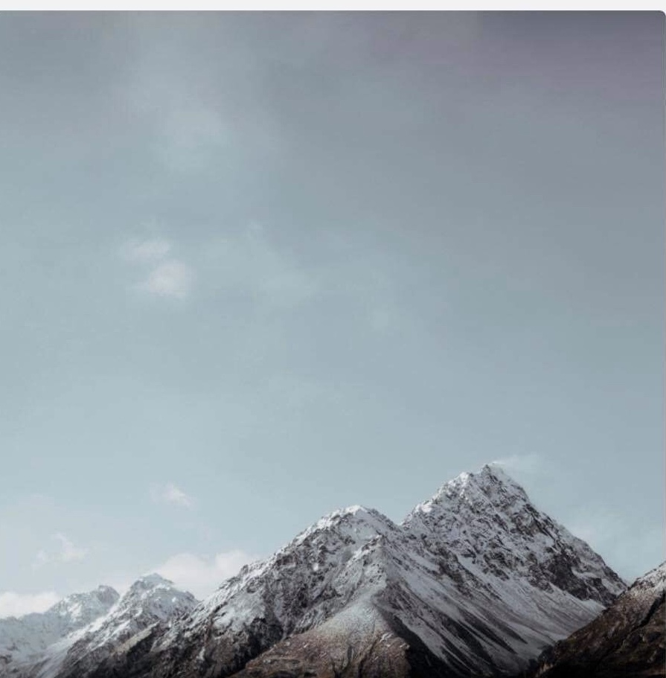
Come As You Are

Slide 2
Come out of sadness. From wherever
you've been.
Come broken hearted.
Let rescue begin.
Come find your mercy.

Slide 3
Oh sinner come kneel. Earth has no sorrow. That heaven can't heal. Earth has no sorrow. That heaven can't heal.

Slide 4
So lay down
your burdens.
Lay down your shame.
All who are broken,
Lift up your face.

Slide 5
Oh wanderer
come home.
You're not too far.
So lay down your hurt.
Lay down your heart.
Come as you are.

Slide 6
There's hope for
the hopeless.
And all those
who've strayed.
Come sit at the table.
Come taste the grace

Slide 7
There's rest for
the weary.
Rest that endures.
Earth has no sorrow.
That heaven can't cure.

Slide 8
Come as you are Come as you are Fall in His arms Come as you are

Slide 9
There's joy for the morning Oh sinner be still Earth has no sorrow That heaven can't heal Earth has no sorrow That heaven can't heal

